Slide 1
Real-Time Patient Health Alert System
Kafka • Spark Streaming • Python • Real-Time UI

Slide 2
Problem Statement
Continuous monitoring of patient vitals is critical
Manual systems fail to detect emergencies in real time
Hospitals require scalable real-time alerting systems

Slide 3
Solution Overview
IoT-like data generation using Kafka producers
Spark Structured Streaming for real-time processing
Instant alerts pushed to real-time dashboard

Slide 4
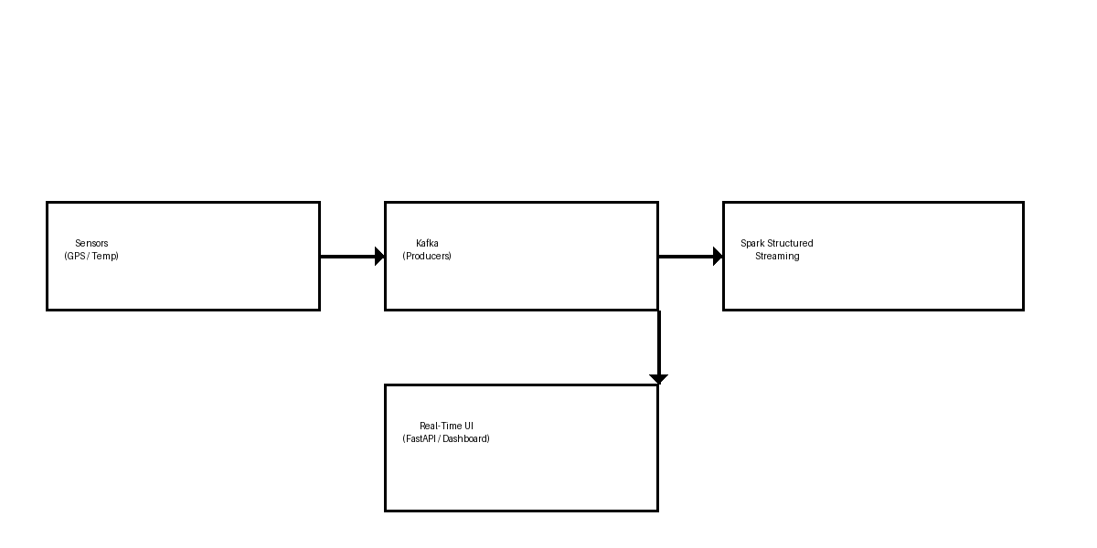
System Architecture

Slide 5
Technology Stack
Apache Kafka – Message streaming
Apache Spark – Real-time analytics
Python – Producers & processing logic
FastAPI / Web UI – Visualization

Slide 6
Kafka Topics
gps_data – Location updates
temperature_data – Patient body temperature
patient_alerts – Critical alerts

Slide 7
Spark Streaming Logic
Consumes data from Kafka topics
Applies threshold-based health rules
Generates alerts for abnormal readings

Slide 8
Real-Time Output
Alerts visible instantly in browser
Doctors receive critical notifications
System runs continuously with low latency

Slide 9
Future Enhancements
ML-based anomaly detection
Cloud deployment (AWS / Azure)
Mobile app notifications

Slide 10
Conclusion
Scalable and reliable real-time health monitoring
Handles high-volume streaming data
Suitable for smart hospitals

